Slide 1
Linked List
1

Slide 2
Linked List :: Basic Concepts
A list refers to a set of items organized sequentially.
  An array is an example of a list.
    The array index is used for accessing and manipulating array elements.
  Problems with array:
    The array size has to be specified at the beginning.
    Deleting an element or inserting an element may require shifting of elements in the array.
2

Slide 3
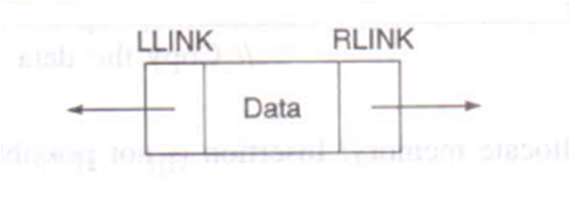
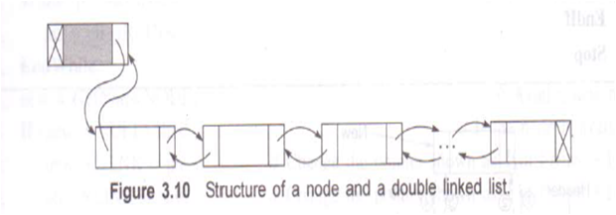
In a singly linked list one can move beginning from the header node to any node in one direction only(from left to right). This is why a single linked list is also known as a one - way list.
On the other hand , a doubly linked list is a two-way list because one can move in either direction , either from left to right or from right to left. (forward or reverse ).
A structure of a node for a double linked list is represented as:

Slide 4
Linked list
Linear data structure
Is an ordered collection of finite, homogeneous data elements called nodes where the linear order is maintained by means of links or pointers
Data | Link

Slide 5
Node: an element in a linked list
A node consists of two fields
Data( to store the actual information)
Link (to point to the next node)
In linked list the adjacency between the elements are maintained by means of links or pointers. A link or pointer is the address of the subsequent element

Slide 6
Difference between array and linked list
Array
Linked list
Elements are stored in consecutive memory locations.
Memory allocated at compile time
Once memory is allocated ,it can not be extended any more.
There for array is known as static data structure.
Elements are stored in different memory location.
Memory is allocated at runtime
Once memory is allocated , it can be varied or extended during it use.
There for linked list is known as dynamic data structure.

Slide 7
Array | Linked list
Operation like insertion, deletion..takes more time in an array | Operation like insertion, deletion takes less time in linkedlist
Memory space is only for data stored | Extra memory space for pointer in every node
It is easier and faster to access the element in an array with the help of index | Time consuming as we have to start traversing from the first element (random access not allowed)

Slide 8
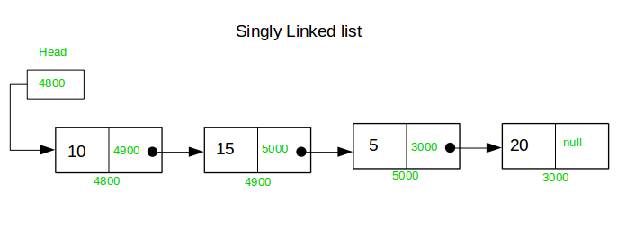

Slide 9
Types of Lists
Depending on the way in which the links are used to maintain adjacency, several different types of linked lists are possible.
  Linear singly-linked list (or simply linear list)
head
A
B
C
22

Slide 10
Circular linked list
  The pointer from the last element in the list points back to the first element.
head
A
B
C
23

Slide 11
Doubly linked list
  Pointers exist between adjacent nodes in both directions.
  The list can be traversed either forward or backward.
  Usually two pointers are maintained to keep track of the list, head and tail.
24

Slide 12
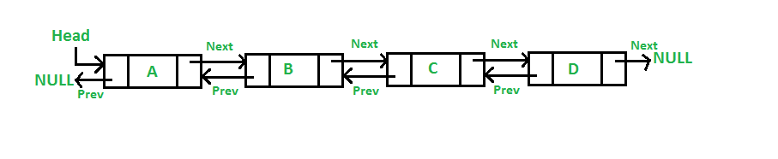

Slide 13
SINGLY LINKED LIST

Slide 14
Singly Linked List
A singly linked list is a linked list in which each node contain only one link pointing to the next node in the list.
In a singly linked list , the first node always pointed by a pointer called HEAD.
If the link of the node points to NULL , then that indicates the end of the list.
Here one can move from left to right only. So it is also called one-way list

Slide 15
Representation of a linked list in memory
Two ways:
  Static representation using array
  Dynamic representation using free pool storage

Slide 16
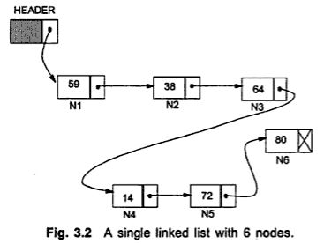
  Static representation
Two arrays are maintained:
  One for data and other for links.

Slide 17
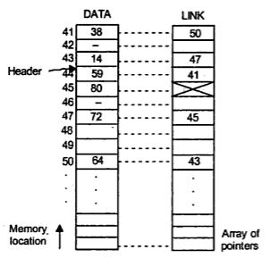
  Static representation
Two parallel arrays of equal size are allocated which should be sufficient to store the entire linked list

Slide 18
  Dynamic representation
The efficient way of representing a linked list is using the free pool of storage.
There is a
  memory bank : Collection of free memory spaces &
  memory manager: a program
Whenever a node is required, the request is placed to the memory manager.
It will search the memory bank for the block. If found, it will be granted.
Garbage collector: Another program that returns the unused node to the memory bank.

Slide 19
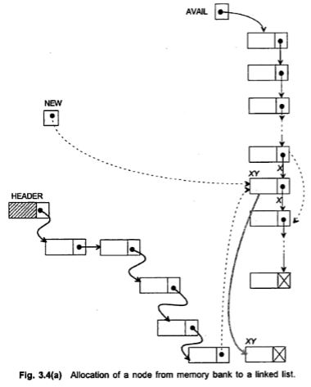
  Dynamic representation

Slide 20
A list of variable memory space is there whose pointer is stored in Avail
For a request of a node, the list Avail is searched for the block of right size
If Avail is null or block of right size is not available the memory will return the size accordingly
Suppose a block is found and let it be ‘xy’, then the memory manager will return the pointer of xy to the caller in a temporary buffer say ‘New’
The newly availed node xy can be inserted at any position in the linked list by changing the pointers of the concerned nodes.

Slide 21
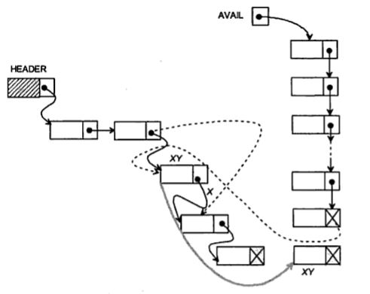
  Dynamic representation
  Returning a node to memory bank

Slide 22
Operations on a singly linked list are
Traversing (Display) all the elements of the list.
Inserting a node into the list.
i. insert an element at the beginning of the list
ii. insert an element at the end of the list
iii. insert an element at the specified position in the list
3. Deleting a node from the list
i. Delete an element from the beginning of the list
ii. Delete an element at the end of the list
iii. Delete an element at the specified position in the list

Slide 23
4. Copying the list to make a duplicate of it.
5. Merging the linked list with another one to make a larger list.
6. Searching for an element in the list.
7. Count the number of elements.

Slide 24
Creating a List
29

Slide 25
Representation of a node using structure
struct node
{
int data;
struct node *link;
};

Slide 26
Creation of a new node
P=(struct node *)malloc(sizeof struct node);
A node is created named ‘p’
P data=8
P link=null
8 | null

Slide 27
Procedure Getnode(node)

Slide 28
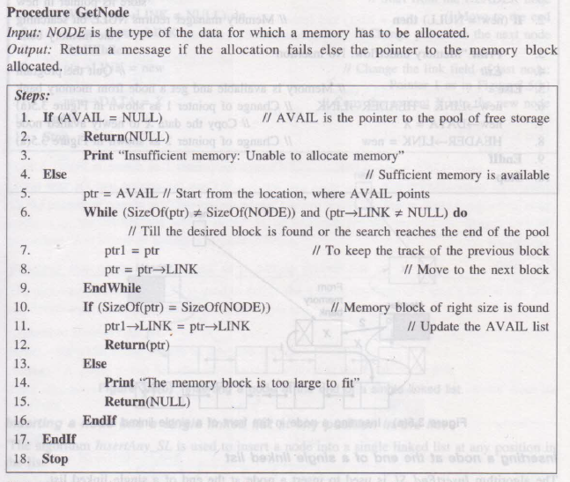

Slide 29
Traversing a single linked list
Here we visit every node in the list starting from the first node to the last one.
head
ptr
ptr
ptr
10
20
30
null
Data next
Data next
Data next

Slide 30
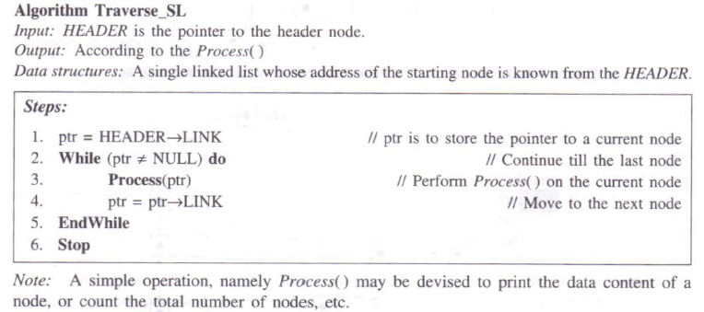

Slide 31
Insertion
There are various positions where a node can be inserted:
Inserting at the front ( as a first element)
Inserting at the end( as a last element)
Inserting at any other position

Slide 32
Insertion- At the beginning
Consider a linked list with 3 nodes
We want to insert a new node temp at the beginning of the list
head
10
20
30
null
5

Slide 33
Insertion- At the beginning
Now temp is inserted at 1st position
temp
temp-> link=head
head=temp
5
head
10
20
30
null

Slide 34
Inserting a node at the front of a single linked list.
The algorithm InsertFront_SL is used to insert a node at the front of a single linked list.
Algorithm InsertFront_SL
Input: HEADER is the pointer to the header node and X is the data of the node to be inserted.
Output: A single linked list with a newly inserted node at the front of the list.
Data Structures: A single linked list whose address of the starting node is known from the HEADER.

Slide 35
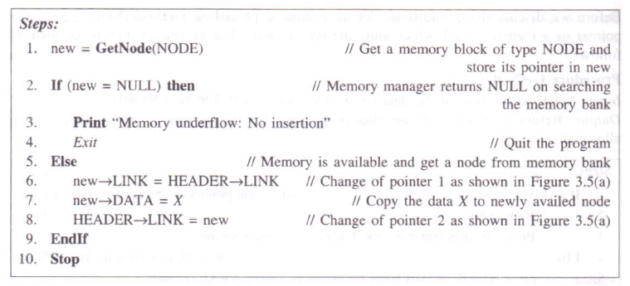

Slide 36
Insertion- At the end
Consider a linked list with 3 nodes
We want to insert a new node temp at the end of the list
head
10
20
30
null
40

Slide 37
Insertion- At the end
List should be traversed first.
Now temp is inserted at the end
head
10
20
30
40

Slide 38
Insertion- At the end
Here first we need to traverse the list to get the last node.
ptr
ptr
ptr
head
10
20
30
null
Data next
Data next
Data next
40
null
temp

Slide 39
Inserting a node at the end of a single linked list.
The algorithm InsertEnd_SL is used to insert a node at the end of a single linked list.
Algorithm InsertEnd_SL
Input: HEADER is the pointer to the header node and X is the data of the node to be inserted.
Output: A singe linked list with a newly inserted node having data X at the end of the list.
Data Structures: A single linked list whose address of the starting node is known from the HEADER.

Slide 40
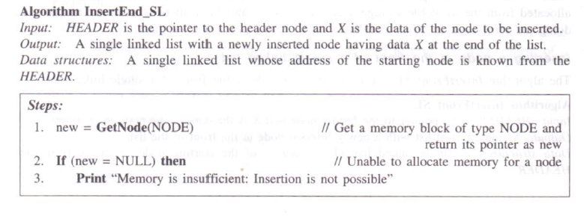

Slide 41
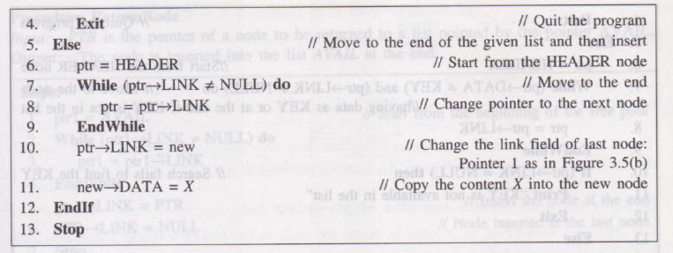

Slide 42
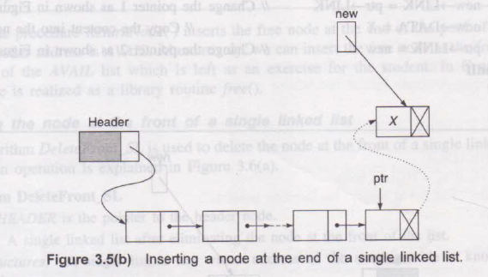

Slide 43
Insertion- At any position in the list
Consider a linked list with 3 nodes
We want to insert a new node temp after node 20
head
10
20
30
null
25

Slide 44
Insertion- After a node
Now temp is inserted after node 20
ptr
ptr
head
25
10
20
30

Slide 45
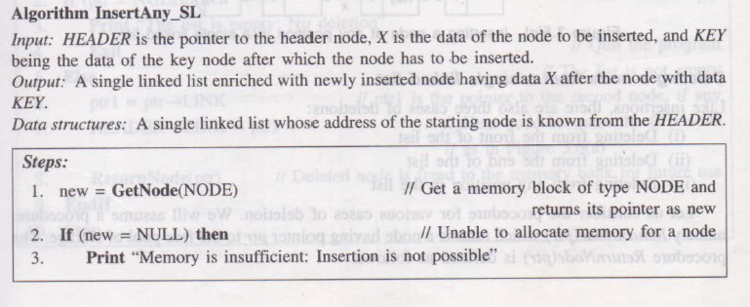

Slide 46
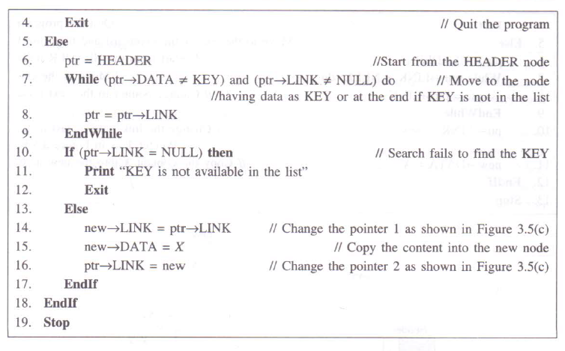

Slide 47
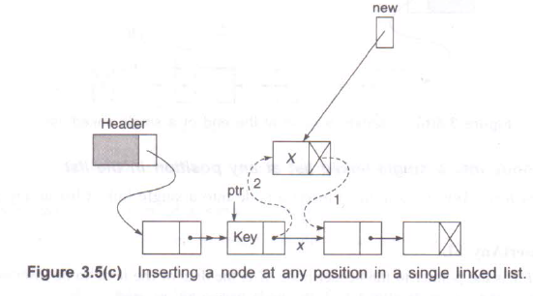

Slide 48
Deletion
In a linked list, an element can be deleted:
From the 1st location
From the last location
From any position in the list

Slide 49
Deletion- From the beginning
Consider a linked list with 3 nodes
We want to delete a node from the beginning of the list
head
10
20
30
null
10

Slide 50
Deletion- From the beginning
Now node 10 is deleted from the beginning
1. If (head==NULL)
Print ‘list empty’
Else
head=head-> link
head
10
20
30
null

Slide 51
Deletion- From the end
Consider a linked list with 3 nodes
We want to delete a node from the end of the list
head
prev
current
prev
current
10
20
null
30
null
30

Slide 52
Deletion- From the end
Set current=head, prev=head
Repeat while(current-> link!=null)
prev= current
current=current->link
prev->link=null

Slide 53
Deletion- From any position
Consider a linked list with 4 nodes
We want to delete a node from the middle of the list
head
30
40
10
20
30

Slide 54
Deletion- From intermediate location
Consider a linked list with 4 nodes
We want to delete a node from the middle of the list
head
prev
current
prev
current
30
null
40
10
20
30

Slide 55
Delete a node key
Read the value key that is to be deleted //30
Set current=head, prev=head
Repeat while(current->link!=null)&& (current-> data!=key)
prev= current
current=current->link
If (current==null)
print “element not found”
Else
prev->link=current->link

Slide 56
Merging
Two linked list L1 and L2.
Merge L2 after L1
head1
10
20
Data next
Data next
head2
10
20
Data next
Data next

Slide 57
Merging
Set ptr= head1
While(ptr->link!= NULL)
ptr=ptr->link
ptr->link=head2
Head=head1
Stop

Slide 58
cursor based implementations of linear structures
A cursor-based implementation of linear structures, like linked lists, is an alternative to traditional pointer-based implementations, particularly useful in environments where direct memory allocation and deallocation are restricted or less efficient. Instead of using memory addresses as pointers, it utilizes array indices to simulate links between nodes.

